Slide 1


Model Answer
Microsoft’s Culture
Transformation
This model answer is designed to illustrate a complete professional presentation of Microsoft’s culture transformation. You were not asked to provide this level of detail. We hope you see the content of your answer represented throughout the presentation. We want to help you develop your presentation skills and give you a window into how we communicate about our culture and live it.

Slide 2
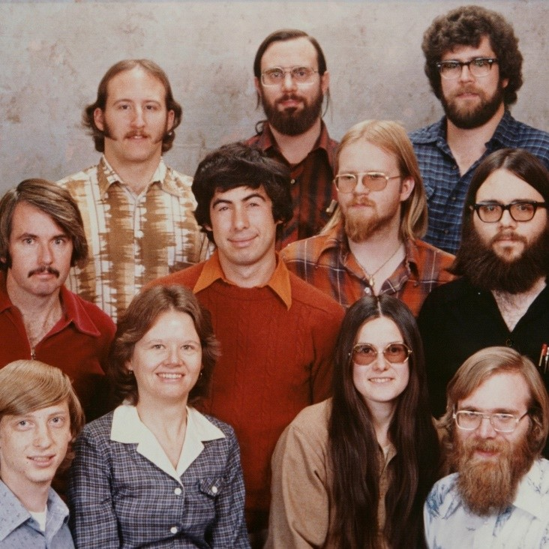

When we started

Slide 3
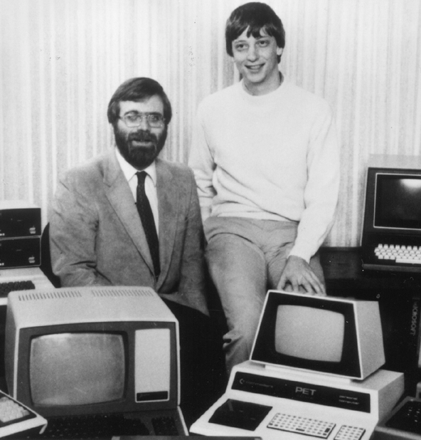


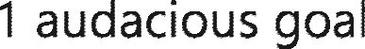






Slide 4

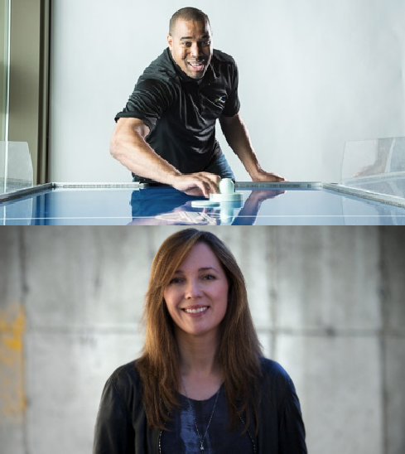
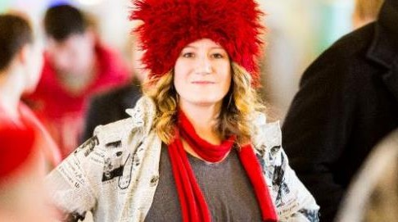
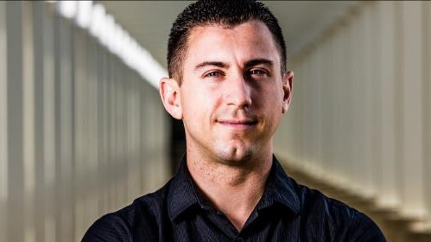
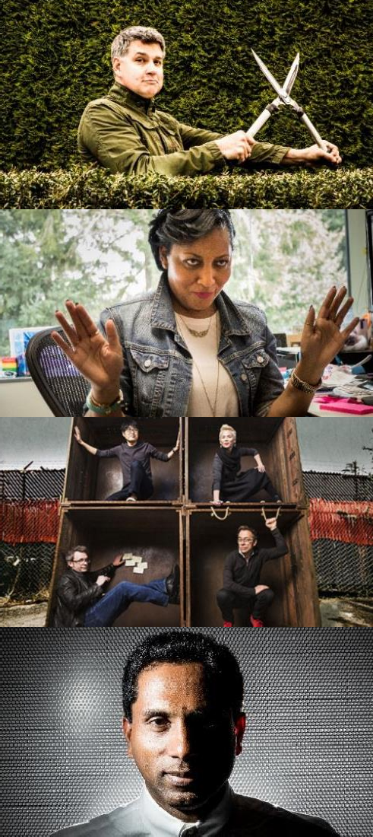
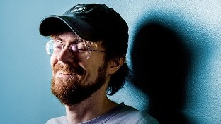

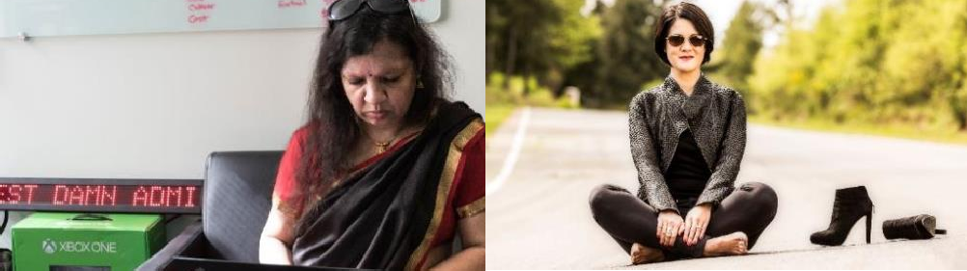
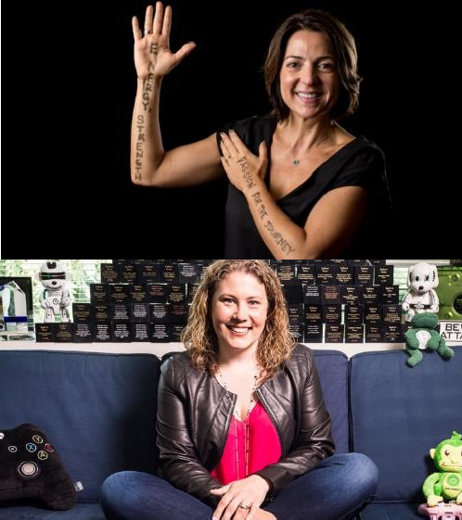
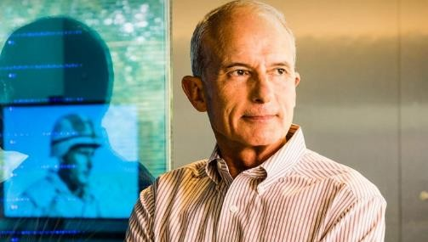

We’ve grown from a start-up to a $110 billion company
There are now more than 14,000 employees in 120 countries
We started with 13 employees in 1978
Our strength has always been our employees

Slide 5


A new day

Slide 6
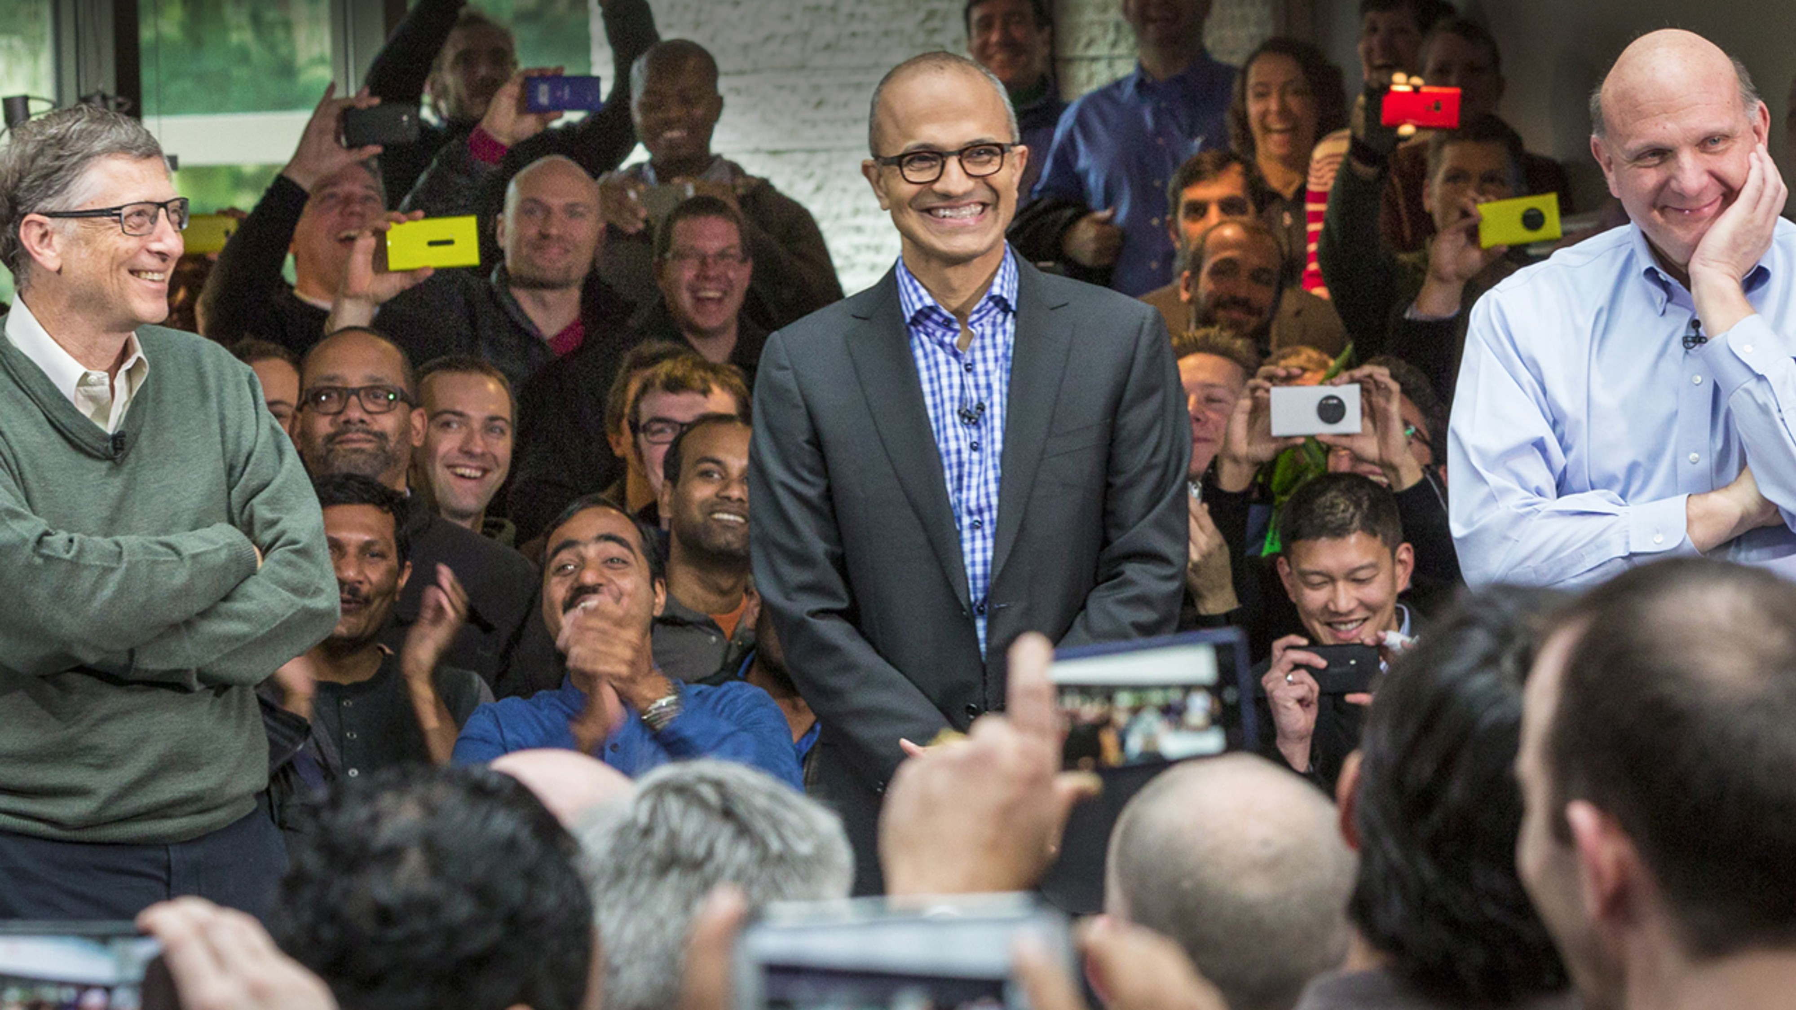
February 2014 our 3rd CEO in 40 years – Satya Nadella
We were a good solid company
However, we had a perspective problem
Were middle aged
The world was changing fast & we needed to keep up
Satya said ‘we needed to rediscover our soul’

Slide 7






Microsoft’s mission
Empower every person and every organization on the planet to achieve more

Slide 8
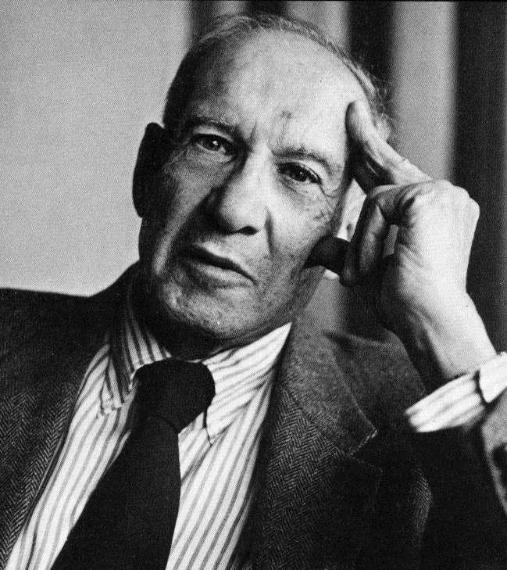
“Culture eats strategy for breakfast.”
– Peter Drucker

Slide 9
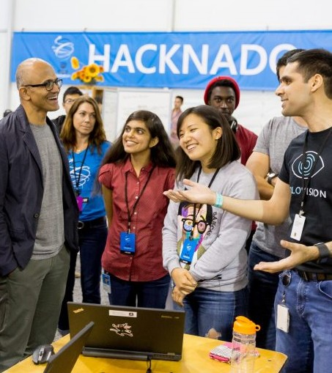
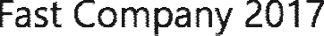
“The last thing I wanted was for employees to think of culture as “Satya’s thing.” I wanted them to see it as their thing. The key to the culture change was individual empowerment.
- Satya Nadella,
The concept that there is one culture we will freeze and forget is not what will work. We have anchored on growth mindset, a learning living culture. If we take the posture that every day we will be better than the previous day – that is the culture we aspire to. This comes with healthy amounts of curiosity and humility to ensure we’re always learning.

Slide 10



We identified four attributes that allow growth mindset to flourish and vice versa. Obsessing over what matters to our customers, becoming more diverse and inclusive in everything we do and create, operating as one company instead of multiple siloed businesses and lastly, to making a difference in the lives of each other, our customers and the world around us.
This means anyone can change learn and grow
We believe potential is nurtured and not pre- determined
We should always be learning and curious
We should try things and not be afraid to fail
Growth Mindset

Slide 11




We fundamentally believe that we need a culture founded in a growth mindset. It starts with a belief that everyone can grow and develop; that potential is nurtured, not pre-determined; and that anyone can change their mindset. We need to be always learning and insatiably curious. We need to be willing to lean in to uncertainty, take risks and move quickly when we make mistakes, recognizing failure happens along the way to mastery. And we need to be open to the ideas of others, where the success of others does not diminish our own.
Growth Mindset
It’s rare to have a meeting take place, a day, or a week go by where growth mindset – learning over knowing – doesn’t come up. Growth mindset started as a phrase, anchored in a psychological model, and has turned into a way of interacting and doing business.
Knower, genius oriented
Learners, always improving, developing value
Fixed mindset, ignore input, focus on own success
Embrace challenge, persist against setbacks, value success of others
Cannot risk, cannot fail
Celebrate risks, small and large, failure leads to mastery
Limit feedback, stay on track
Give & get feedback, reflection, iteration

Slide 12
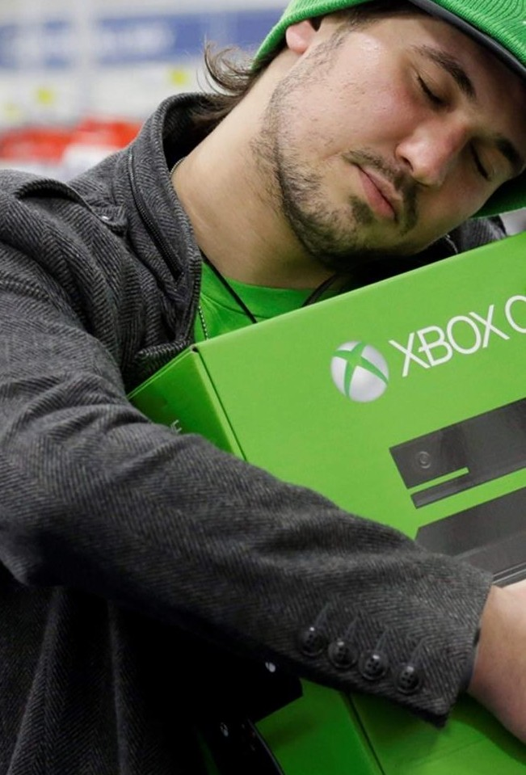

We will learn about our customers and their businesses with
a beginner’s mind and then bring solutions that meet their needs. We will be insatiable in our desire to learn from the outside and bring it into Microsoft, while still innovating to surprise and delight our users.
Customer
obsessed
Internally driven
Customer success outcomes
Feature focus
Deliver customer solutions
Customer feedback
on developed products
Active listeners, using customer feedback early and often throughout lifecycle
Decision drivers: project plans, politics, intuition
Decision drivers: customer input, data, behavior

Slide 13


The world is diverse. We will better serve everyone on the planet
by representing everyone on the planet. We will be open to learning our own biases and changing our behaviors so we can tap into the collective power of everyone at Microsoft. We don’t just value differences, we seek them out, we invite them in. And as a result, our ideas are better, our products are better and our customers
are better served.
Diverse
& Inclusive
Aware of diversity
Celebrating and accountable for diversity
Acknowledging differences
Value and enable differences
View diversity as a narrow conversation
Inclusive behaviors and attitudes are core
Diversity and Inclusion is a commitment - a key business priority
Diversity is an activity

Slide 14

We are a family of individuals united by a single, shared mission. It’s our ability to work together that makes our dreams believable and, ultimately, achievable. We will build on the ideas of others and collaborate across boundaries to bring the best of Microsoft to our customers as one. We are proud to be part of team Microsoft.
One
Microsoft
A company of companies, siloed
Connected, working together for shared goals
Information is power — hold closely
Information is powerful — transparent and share openly
Value individual contributions — internal competition
Value contributions to and with others — we are better together
We optimize for our team
We optimize for Team Microsoft

Slide 15


If we do all of this, we will achieve our mission to empower every person and organization on the planet. Beyond that, we will make a difference and find deep meaning in our work. We stand in
awe of what humans dare to achieve and are motivated every day to empower others to do more and achieve more through
our technology and innovation.
Making a
difference
Making a difference isn’t just a result or an outcome of culture. We believe each of us can improve at making a difference by applying a growth mindset to discovering our purpose and working on things that ladder-up to something larger than ourselves. We truly believe we have an opportunity to change the world we live in.
Incrementalism
Bold ambitions
Value activity
Value purpose and impact — achievement and effect
Decision complexity, hierarchy oriented
Simplicity, clarity — empowerment
Microsoft changes the world
We change the world, together

Slide 16

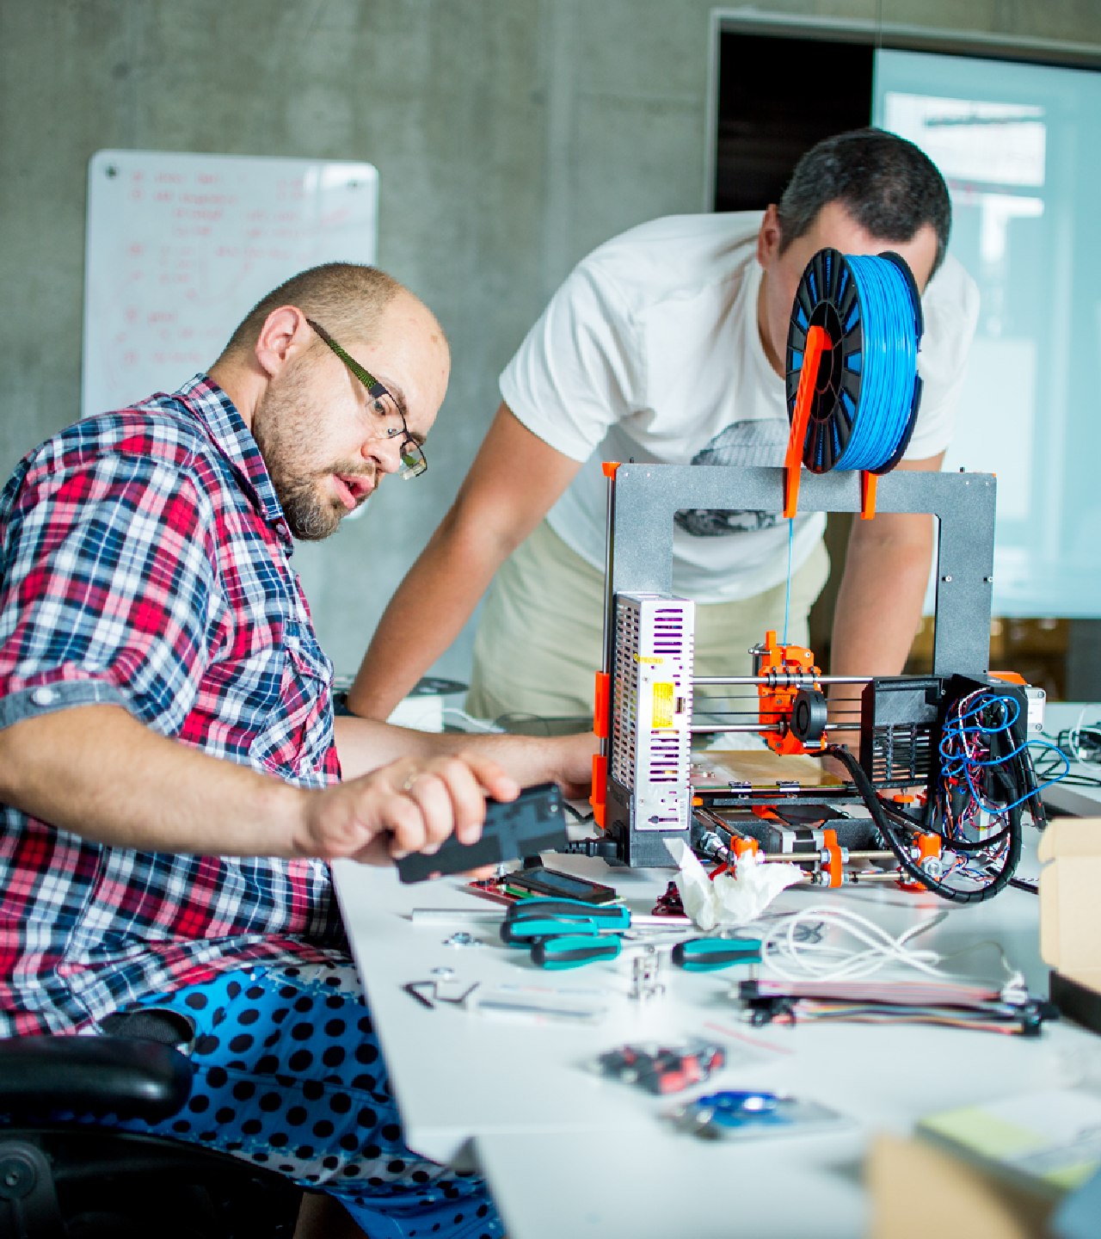

Make it real

Slide 17
Create clarity
Synthesize the complex Ensure shared understanding Define a course of action
Leadership
principles
Culture starts at the top, but it shouldn’t stay there. As you’ve seen – we started at the top with a leader-led effort but that isn’t self-sustaining. Our culture can’t depend on a single person.
Leadership matters. If we don’t have leaders who hold our values, we won’t get very far.
Generate energy
Inspire optimism, creativity, and growth
Create an environment where everyone does their best work Build organizations that are stronger tomorrow than today
Deliver success
Drive innovation that people love
Be boundary-less in seeking solutions Tenaciously pursue the right outcomes

Slide 18
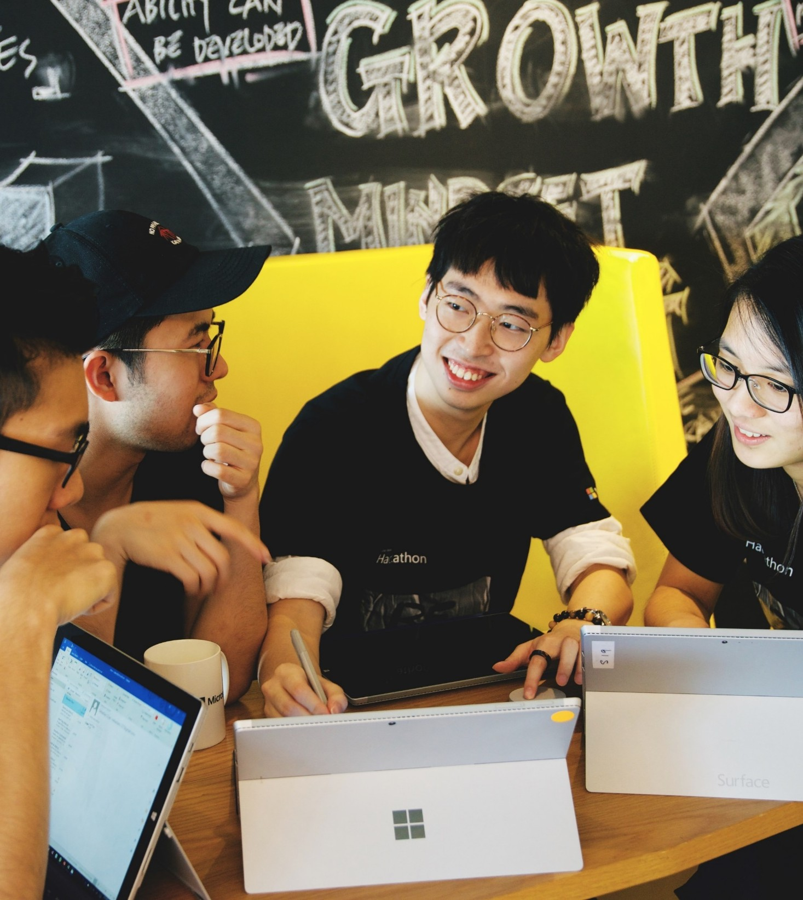

Culture in action

Slide 19
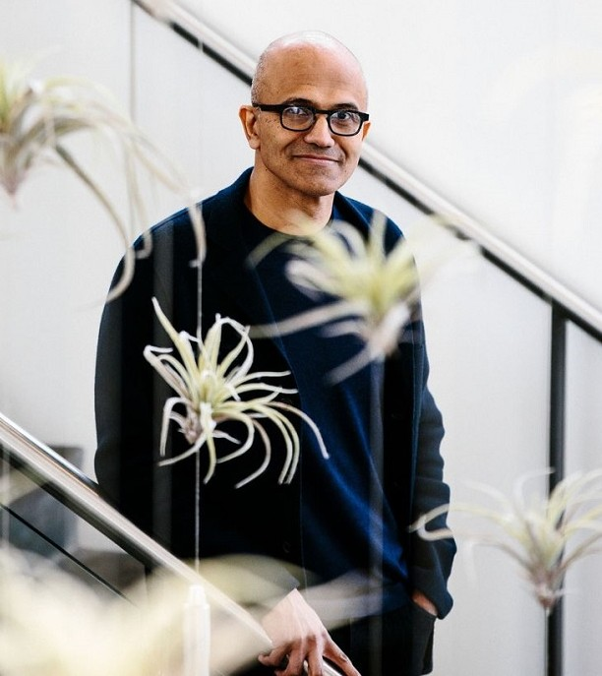
“I always say this to any student who is joining Microsoft or looking to join Microsoft. I say to them, look, if you want to be cool go look for someplace else. But if you want to join a company that is committed to making others cool, join Microsoft.”
– Satya Nadella

Slide 20
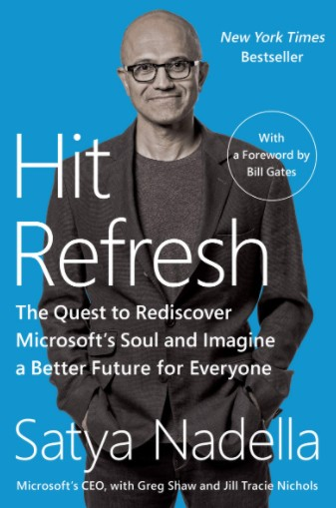
Meet the people who are empowering others to achieve more!
Meet the people who have been inspired by Microsoft’s culture to ‘come as they are, do what they love!’
Recommended Reading:
Hit Refresh: The Quest to Rediscover Microsoft's Soul and Imagine a Better Future for Everyone Kindle Edition
by Satya Nadella (Author), Greg Shaw (Author), Jill Tracie Nichols (Author), Bill Gates (Foreword)

